Slide 1

Community, the secret ingredient for DevOps
Nathen Harvey
@nathenharvey
This presentation by Chef is licensed under a Creative Commons Attribution-ShareAlike 4.0 International License.

Slide 2
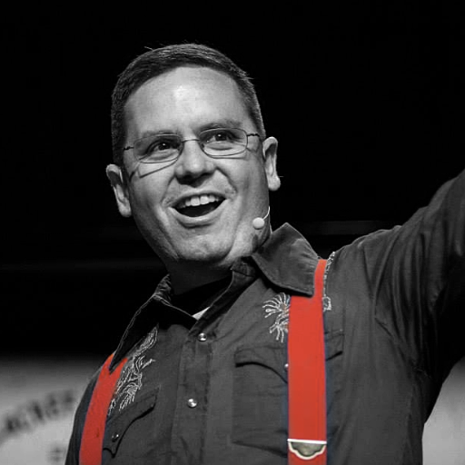

Nathen Harvey
VP, Community Development at Chef
Co-host of the Food Fight Show Podcast
Occasional farmer – http://ei.chef.io
Love eggs – http://eggs.chef.io
Part-time detective - http://bit.ly/detectivedecker
@nathenharvey
nharvey@chef.io

Slide 3

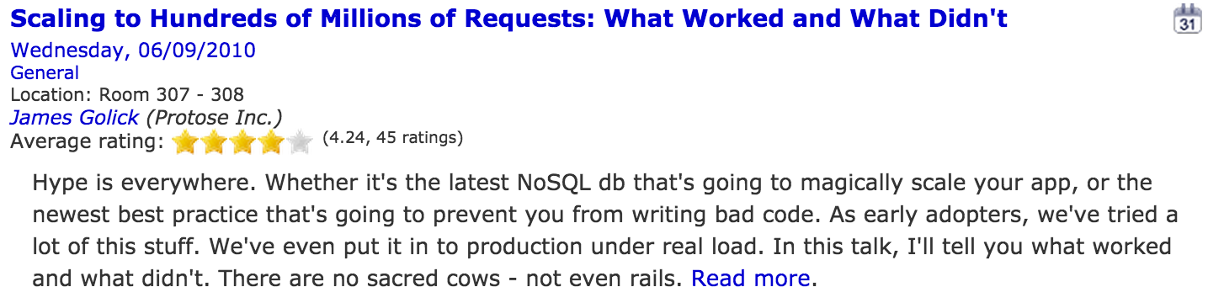
RailsConf 2010
“A hashtag does not a movement make.”

Slide 4
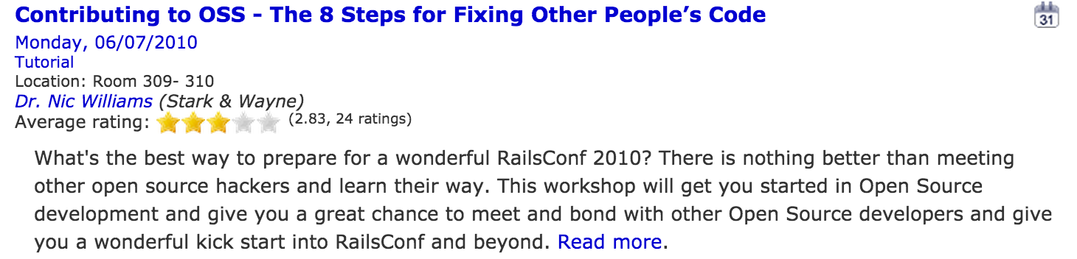
RailsConf 2010

Slide 5
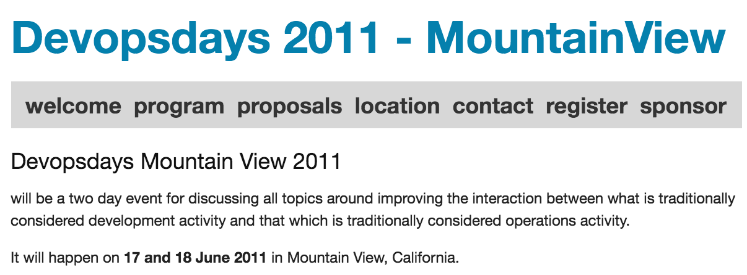

Slide 6
Community
Highly distributed
Leverage social tools
Leverage events for ideation
Open to everyone

Slide 7
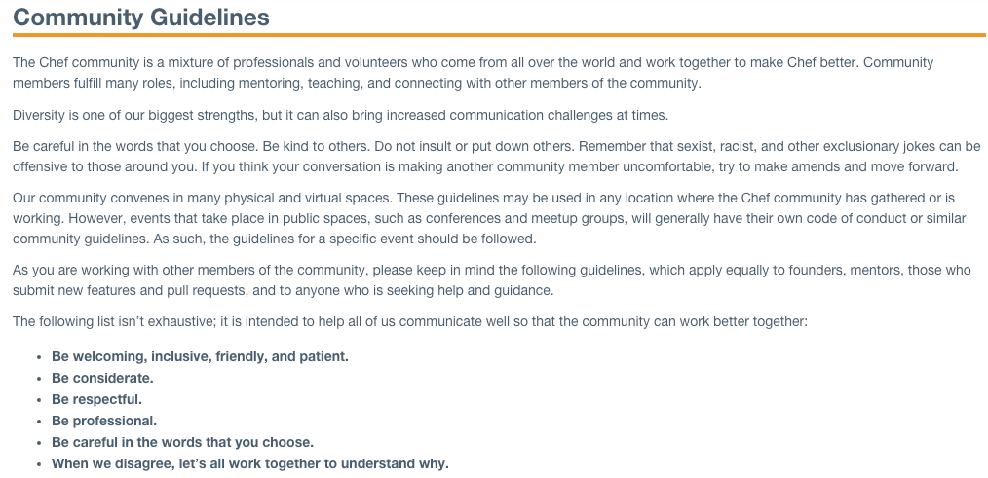
Notes:
Our community convenes in many physical and virtual spaces. The community guidelines may be used in any location where the Chef community has gathered or is working.

Slide 8
Forming Communities
Community of Practice
Jumpstart Kit
Knowledge Share
SHARE
Ease adoption by making it easier to get started
Create a place to share learnings: wiki, forum, email list
Repeatable Demo
Internal Meetup
Make it easy to show the value to engineers & leadership
Setup open meetings to talk about Chef, automation, life
Mentorship vs. Ownership
Transform One Team
Give Up Control
COACH
Get one solid success before moving on
Let others fail before teaching them how to succeed
Make Time for Mentoring
Champions Group
Dedicate time to help others solve problems
Meet regularly with “champions” from different groups
Maintaining Momentum
DevOps Day
Internal Training Program
NURTURE
Plan a 1-day event to showcase demos, talks
Create an internal training program to speed education
Sponsor Local Meetups/Events
Gather Regular Feedback
The local community can be a great recruiting source
Survey Chef users to see where pain points might be

Slide 9
Jumpstart Kit
Ease adoption by making it easier to get started
Time from hire to first production deploy

Slide 10
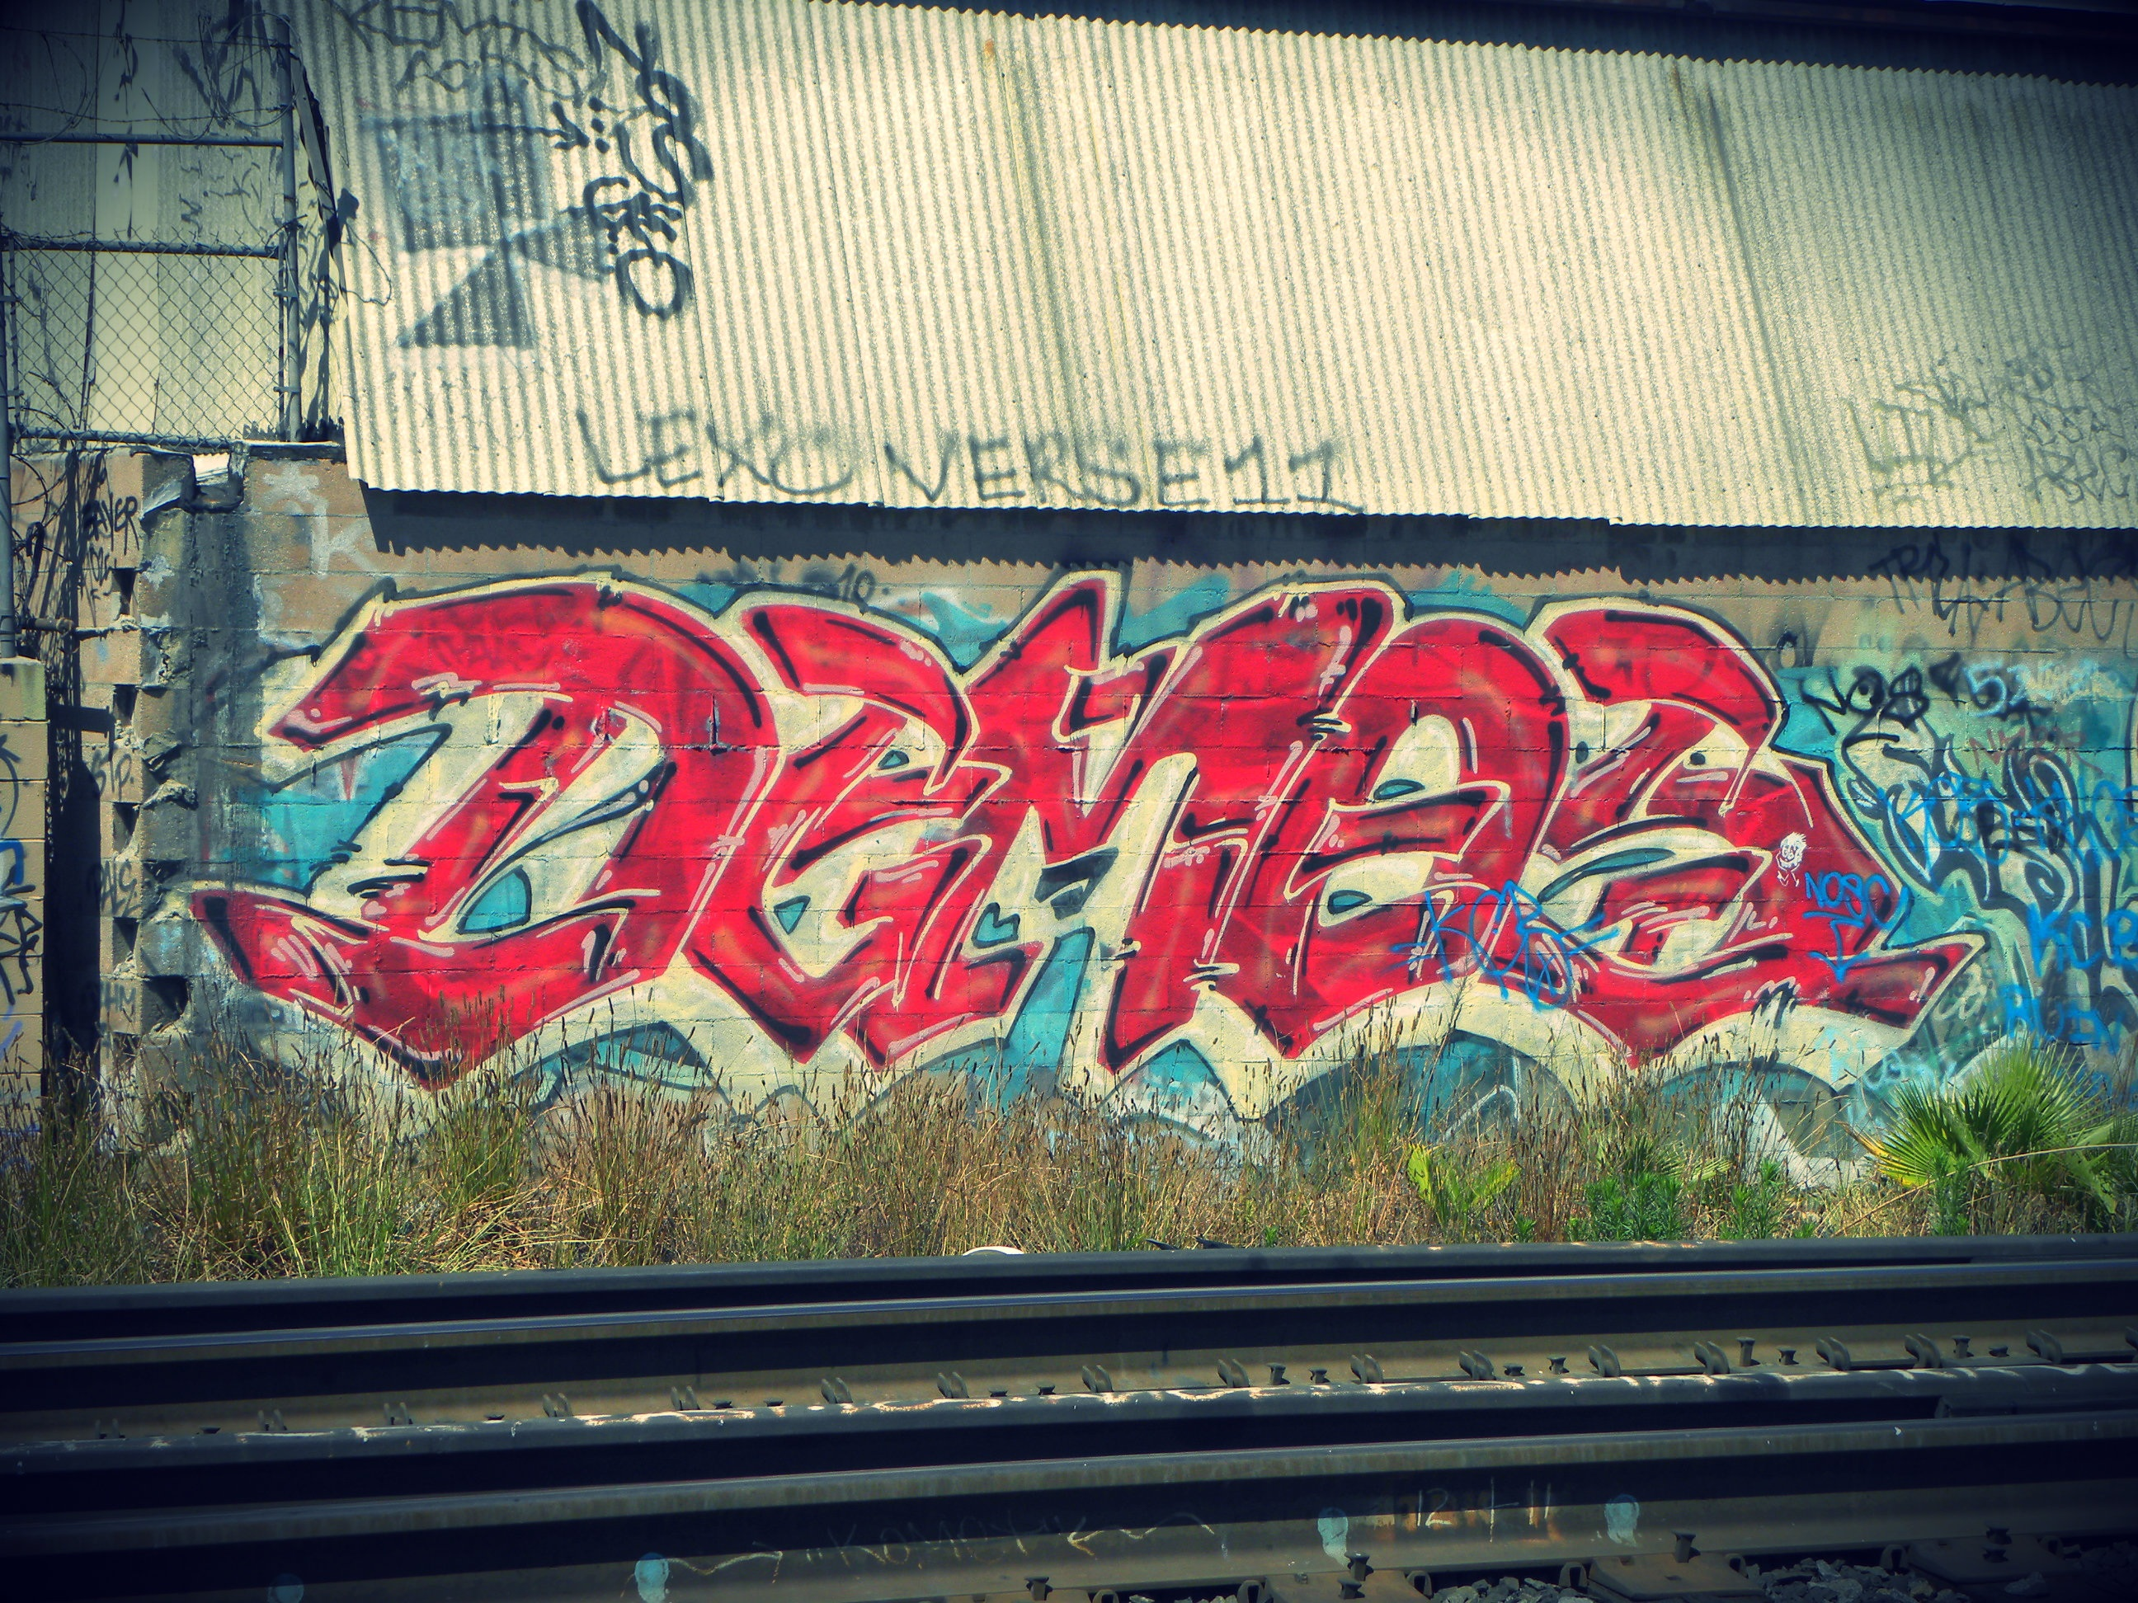
Demo Days!

Slide 11
Demo Days!
Weekly

Slide 12
Demo Days!
Weekly
Anyone with anything to show

Slide 13
Demo Days!
Weekly
Anyone with anything to show
Invite everyone

Slide 14
Demo Days!
Weekly
Anyone with anything to show
Invite everyone
Record it and post it internally

Slide 15
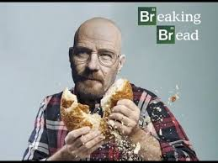
Lunch & Learn

Slide 16

FORM DIVERSE BONDS

Slide 17
FORM DIVERSE BONDS
Take people to lunch, or have meetings, with people outside your specialty

Slide 18
FORM DIVERSE BONDS
Take people to lunch, or have meetings, with people outside your specialty
Ask them what they do, and try and understand their problems and perspective

Slide 19
FORM DIVERSE BONDS
Take people to lunch, or have meetings, with people outside your specialty
Ask them what they do, and try and understand their problems and perspective
Legal, Finance, Sales, Marketing, Business Development, Software Development, Systems Administrators, Security Professionals, Product

Slide 20


Slide 21







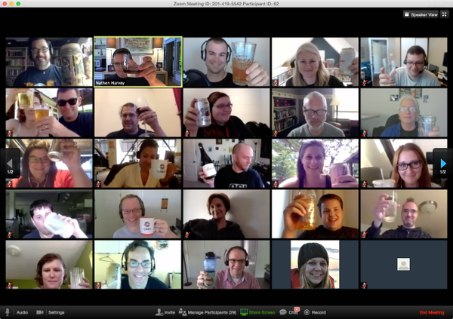



Knowledge Share

Slide 22



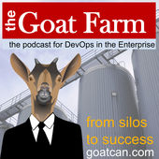

Listen Up!
Notes:
The community is always evolving and moves very quickly. One way to stay on top of the hottest trends and discussions is to subscribe and listen to podcasts. I find that podcasts are a great way to pass the time while commuting, exercising, or doing household chores such as mowing the lawn, doing dishes, or folding laundry.
Some of the podcasts you might be interested in:
- Food Fight Show - the podcast where DevOps Chefs do battle
- DevOps Cafe - hosted by John Willis and Damon Edwards who have both been involved in the DevOps movement from the very early days
- Arrested Devops - because, there's always DevOps in the banana stand!
- The Ship Show - focuses on build engineering, devops, release management and everything in between.
- Ops All The Things - talks about everything related to system operations
- The Goat Farm is the podcast for DevOps in the Enterprise
All of these are available in iTunes or your favorite podcast streaming application.

Slide 23
Forming Communities
Community of Practice
Jumpstart Kit
Knowledge Share
SHARE
Ease adoption by making it easier to get started
Create a place to share learnings: wiki, forum, email list
Repeatable Demo
Internal Meetup
Make it easy to show the value to engineers & leadership
Setup open meetings to talk about Chef, automation, life
Mentorship vs. Ownership
Transform One Team
Give Up Control
COACH
Get one solid success before moving on
Let others fail before teaching them how to succeed
Make Time for Mentoring
Champions Group
Dedicate time to help others solve problems
Meet regularly with “champions” from different groups
Maintaining Momentum
DevOps Day
Internal Training Program
NURTURE
Plan a 1-day event to showcase demos, talks
Create an internal training program to speed education
Sponsor Local Meetups/Events
Gather Regular Feedback
The local community can be a great recruiting source
Survey Chef users to see where pain points might be

Slide 24
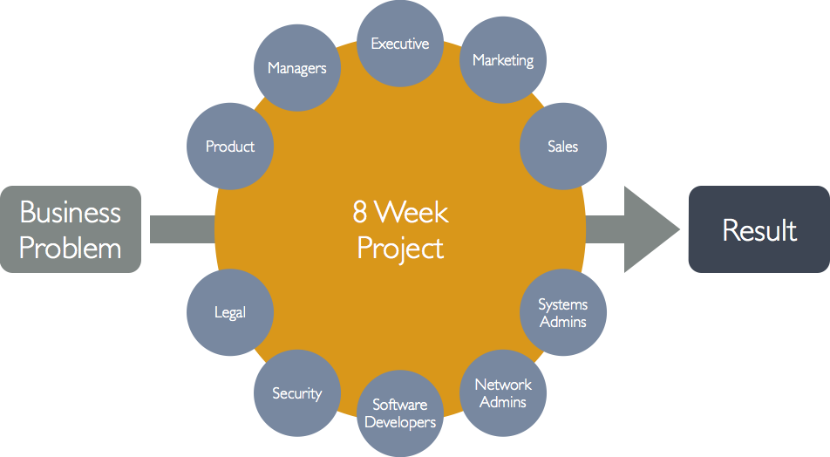
One Team

Slide 25
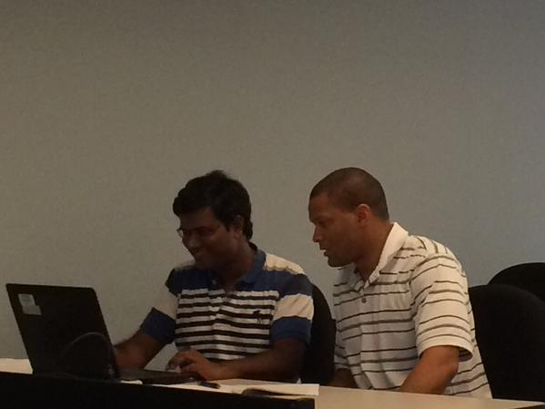

Slide 26
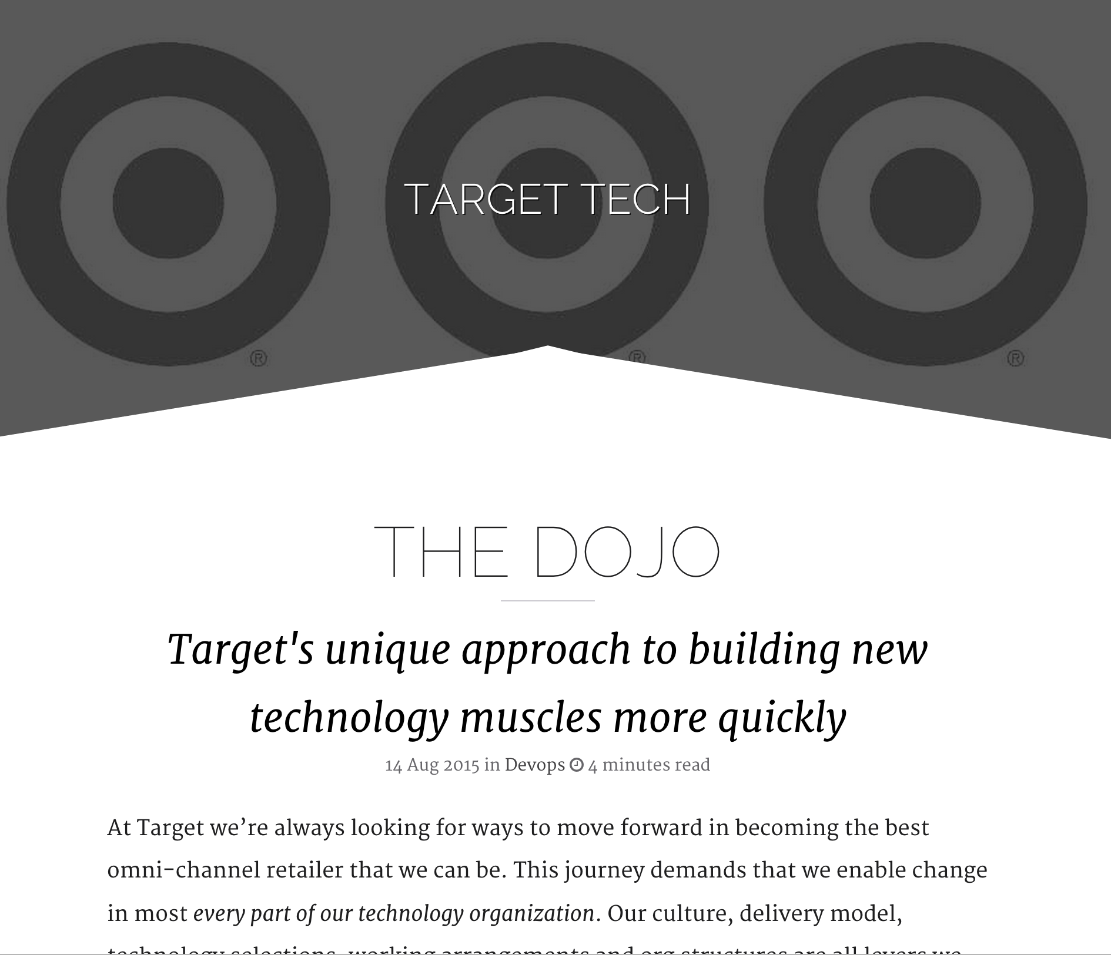

Slide 27
Coaching Kata
What is the target condition?
What is the actual condition?
What are the obstacles?
What is the next step?
When can we see what we’ve learned from that next step?
http://www.lean.org/kata/Archive.cfm?KataItemId=3

Slide 28
Forming Communities
Community of Practice
Jumpstart Kit
Knowledge Share
SHARE
Ease adoption by making it easier to get started
Create a place to share learnings: wiki, forum, email list
Repeatable Demo
Internal Meetup
Make it easy to show the value to engineers & leadership
Setup open meetings to talk about Chef, automation, life
Mentorship vs. Ownership
Transform One Team
Give Up Control
COACH
Get one solid success before moving on
Let others fail before teaching them how to succeed
Make Time for Mentoring
Champions Group
Dedicate time to help others solve problems
Meet regularly with “champions” from different groups
Maintaining Momentum
DevOps Day
Internal Training Program
NURTURE
Plan a 1-day event to showcase demos, talks
Create an internal training program to speed education
Sponsor Local Meetups/Events
Gather Regular Feedback
The local community can be a great recruiting source
Survey Chef users to see where pain points might be

Slide 29
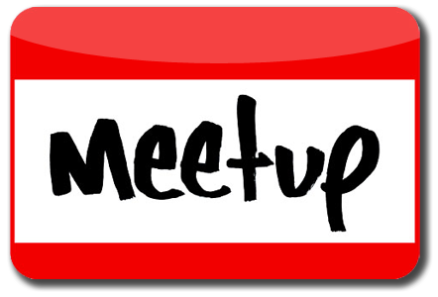
Meetups
Listen
Learn
Present
Interact

Slide 30
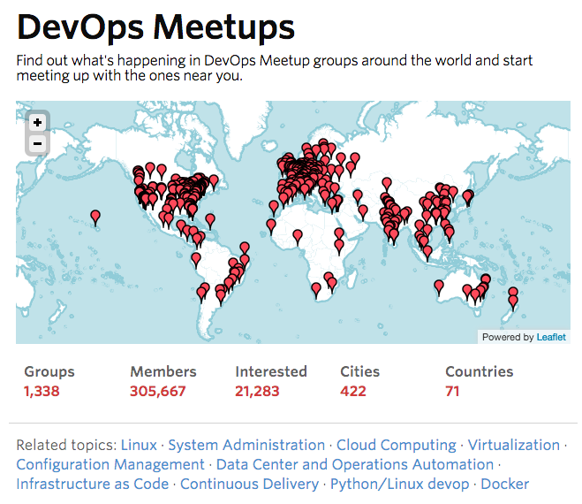
Notes:
I know that suggesting you go to a meetup after work sounds a lot like I'm saying that you should leave work and go to work. That seems odd considering what you'd likely prefer to do after work is go to family. I can certainly appreciate that.

Slide 31

Host Meetups

Slide 32
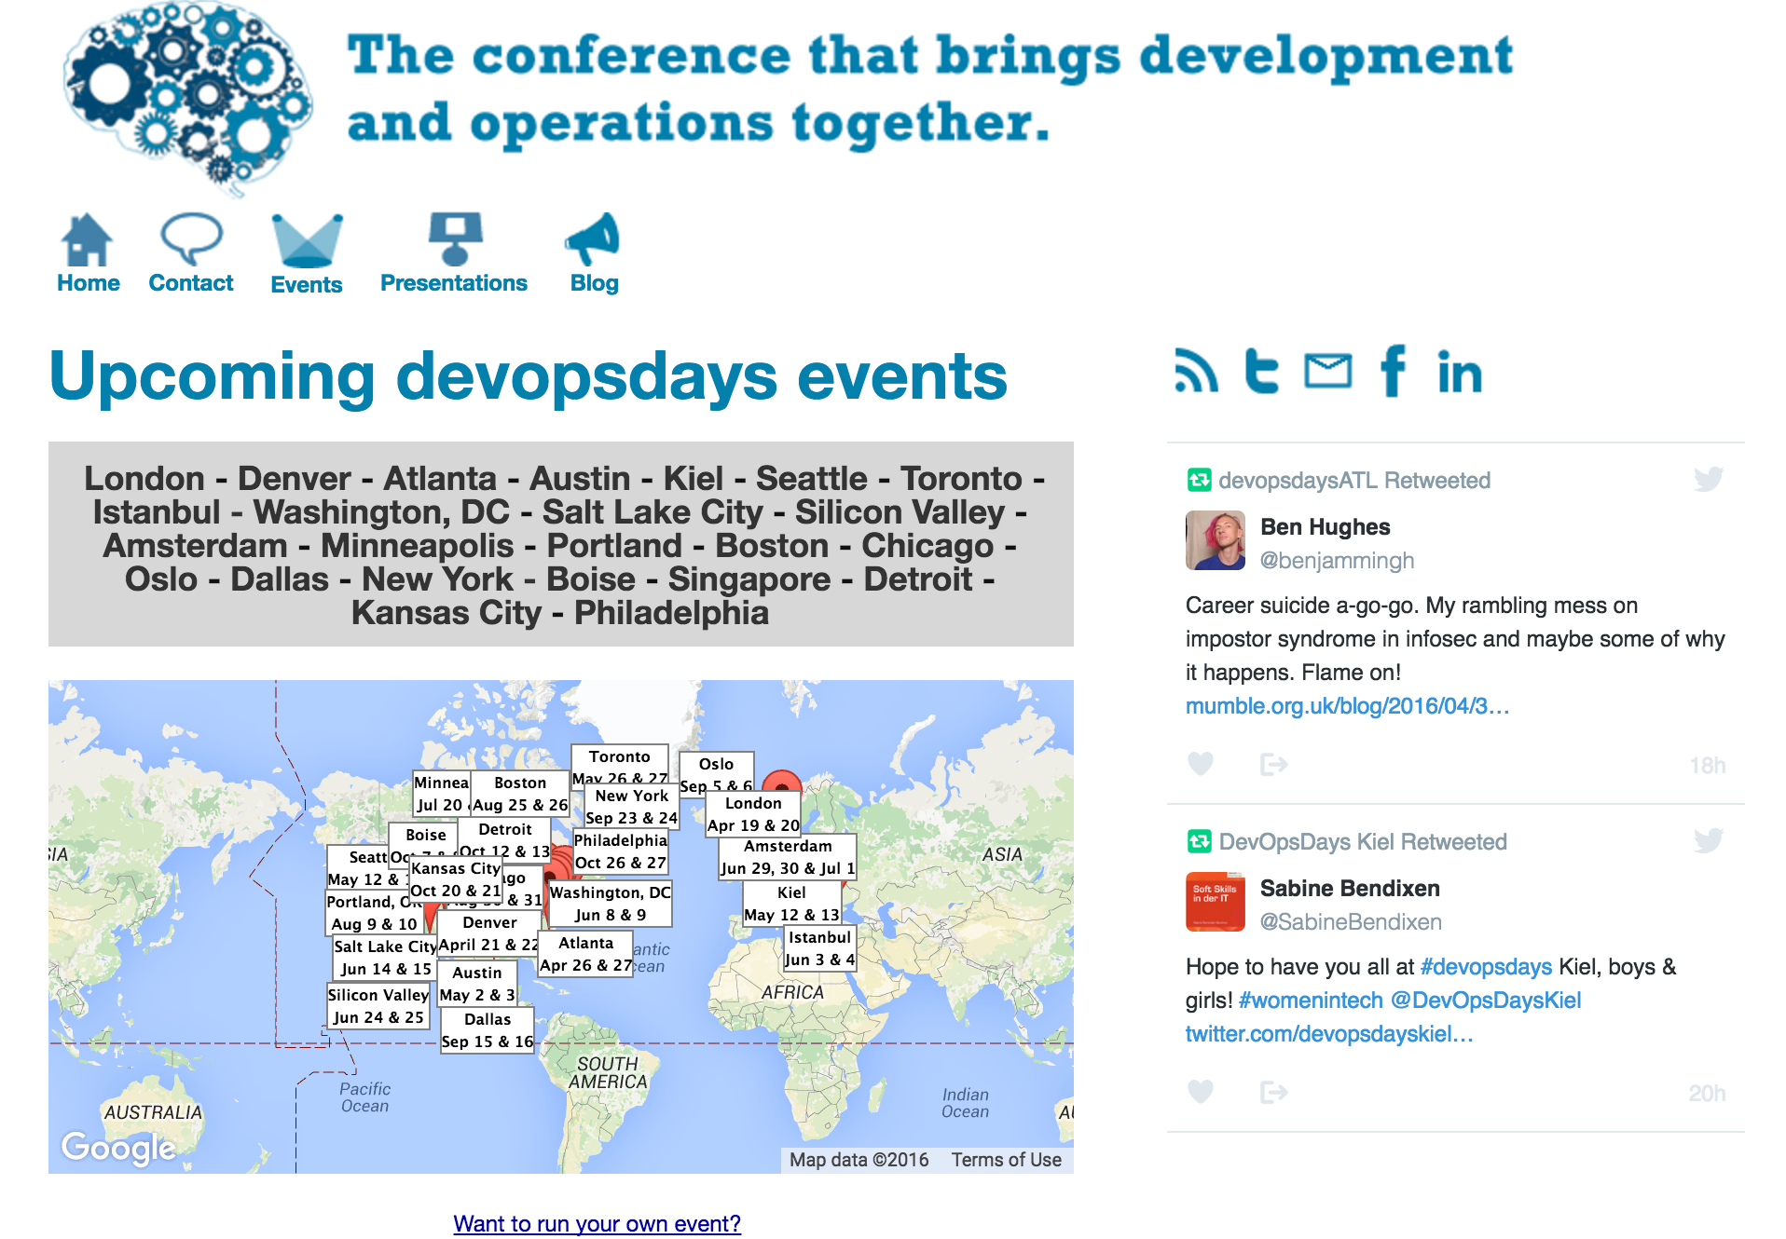

Slide 33
Bring the conference to your team
Internal Events
Automation Symposium
Cloud Symposium
DevOps Symposium
Introduce new meeting formats
Open Spaces
Lean Coffee

Slide 34
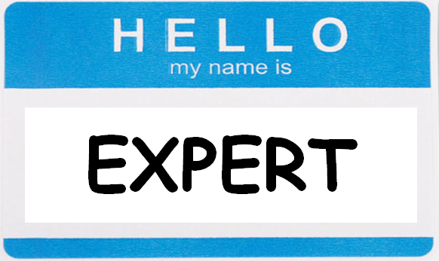

Slide 35

Road trip!

Slide 36

Engineer Exchange

Slide 37
Forming Communities
Community of Practice
Jumpstart Kit
Knowledge Share
SHARE
Ease adoption by making it easier to get started
Create a place to share learnings: wiki, forum, email list
Repeatable Demo
Internal Meetup
Make it easy to show the value to engineers & leadership
Setup open meetings to talk about Chef, automation, life
Mentorship vs. Ownership
Transform One Team
Give Up Control
COACH
Get one solid success before moving on
Let others fail before teaching them how to succeed
Make Time for Mentoring
Champions Group
Dedicate time to help others solve problems
Meet regularly with “champions” from different groups
Maintaining Momentum
DevOps Day
Internal Training Program
NURTURE
Plan a 1-day event to showcase demos, talks
Create an internal training program to speed education
Sponsor Local Meetups/Events
Gather Regular Feedback
The local community can be a great recruiting source
Survey Chef users to see where pain points might be

Slide 38
You are responsible…
For your learning
For your development
For your career
For your teammates
For lots of important things

Slide 39
…but you are not alone!
Find a mentor
Lean on your peers
Mentor someone
Give back

Slide 40
Get involved!
Be active in the community
Step out of the echo chamber
Step out of your comfort zone
Don’t fight stupid, make more awesome!
Jesse Robbins

Slide 41
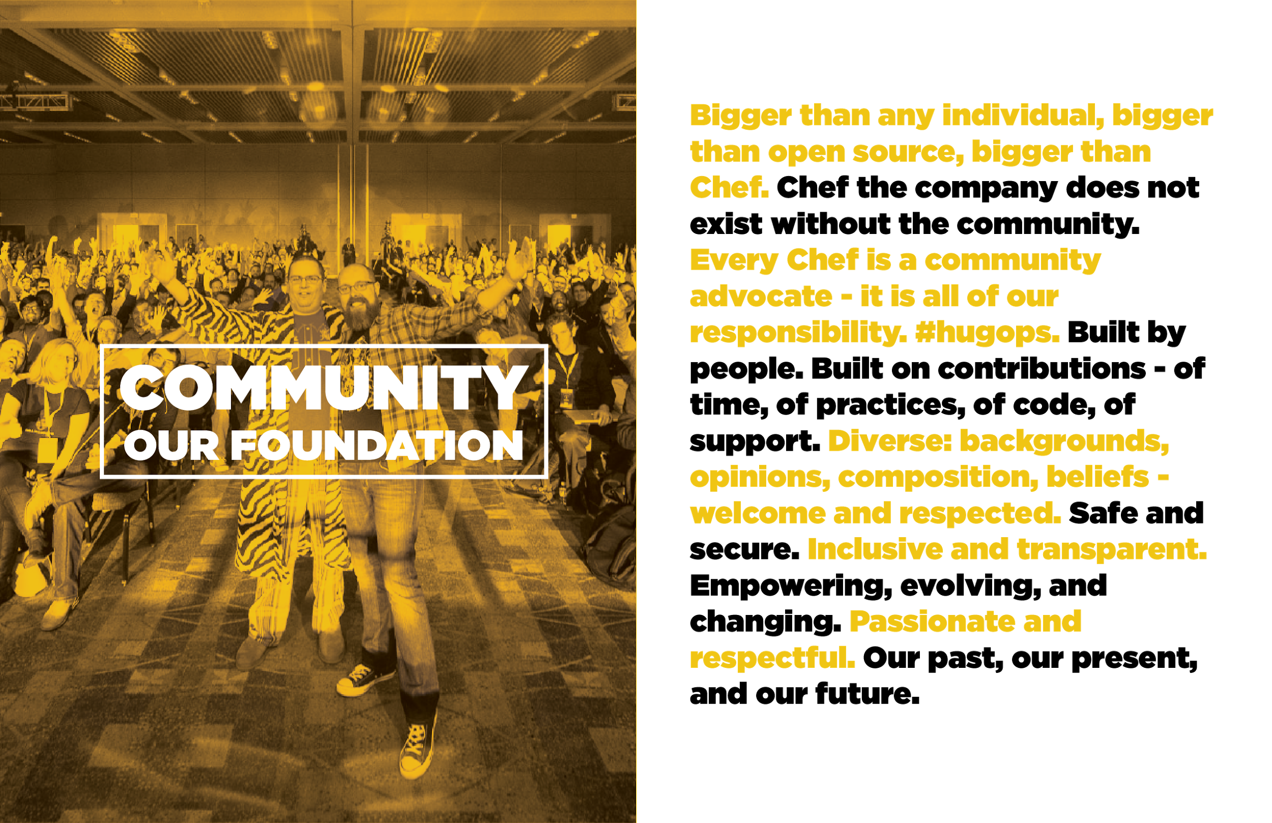

Slide 42


Slide 43
Nathen Harvey
VP, Community Development at Chef
Co-host of the Food Fight Show Podcast
Occasional farmer – http://ei.chef.io
Love eggs – http://eggs.chef.io
Part-time detective - http://bit.ly/detectivedecker
@nathenharvey
nharvey@chef.io

